Slide 1

Snake in Pygame
Ryan

Slide 2
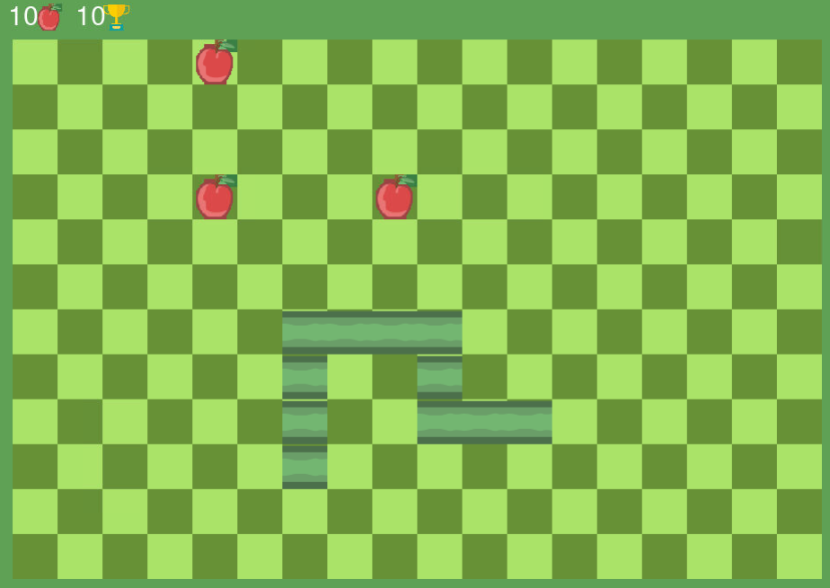
What is Snake?
Haha funne snake eat apple go brrrrrrrrrr
Snake gets chunky when consuming apples

Slide 3
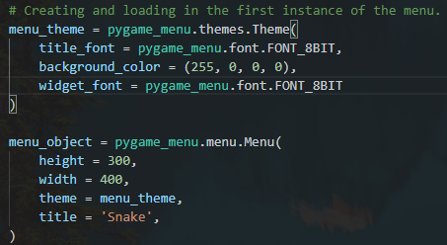
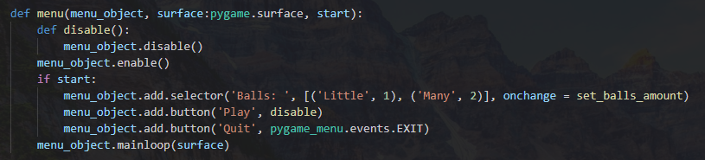
Pygame Menu

Slide 4
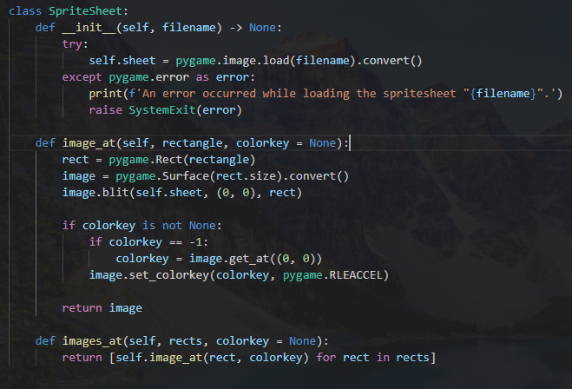
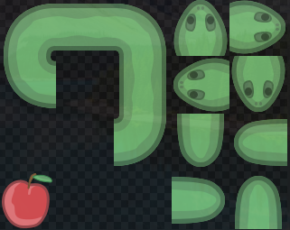
Spritesheet
Found random spritesheet online
64 pixels per individual sprite
Cut each sprite into a pygame.Rect object, then blitted onto pygame.Surface
Boom

Slide 5
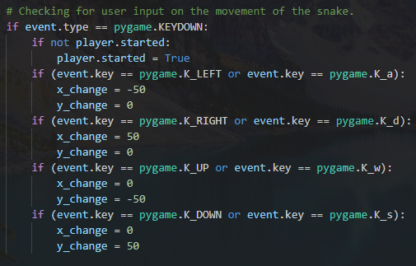
Snake movement
Snake only moves 50 pixels at a time to fit the checkerboard layout

Slide 6












Snake growth
Implement queue to make snake go chunky
Needed in order for snake’s body to follow head
Dequeue when number of apples eaten exceeds current length of snake

Slide 7
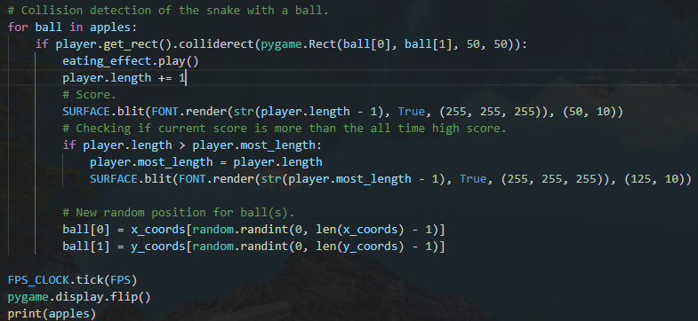
Collision detection
Collision detection for snake to perform consumption of apple
Getting the rect of the snake’s head surface and comparing that with snipped rect using stored coordinates of apple

